Slide 1
Strings and Lists
by Rachael Sera
for Junior Knights

Slide 2
Strings: Review
Strings are groups of characters
Strings are surrounded with quotes “”
Where we’ve seen strings so far
Print statements
Input statements
Message to user, and the default return type

Slide 3
Strings: Review
Strings can be literal strings
A group of characters surrounded by quotes
“car” is a string
Strings can be stored in variables
word = “automobile”
The variable, word, stores the string, “automobile”

Slide 4
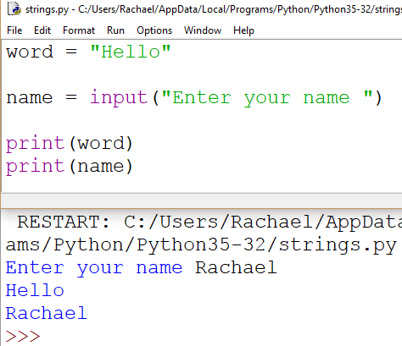
Strings: Review
Store the string “hello” in the variable, word.
Have the user enter a string and store it into the variable, name.
Note: the message to the user in input() is a string too.

Slide 5
String Operations: Length
len(string) returns the length of the string as an integer
The argument is a string. Either a literal string or a variable that holds a string

Slide 6
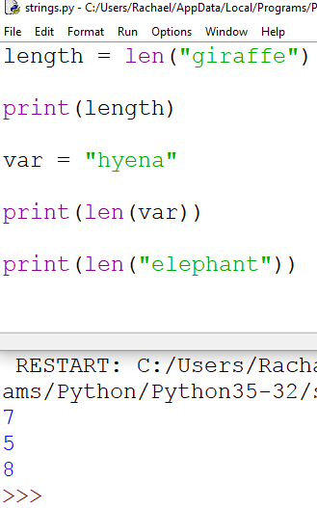
String Length
len() returns the length of the string as an integer.
To see what that value is, we need to print it (the computer calculates it either way, but we can only see it and verify it if we print it!).

Slide 7
String Operations: Concatenation
Concatenation merges strings
Use the + symbol to concatenate strings

Slide 8
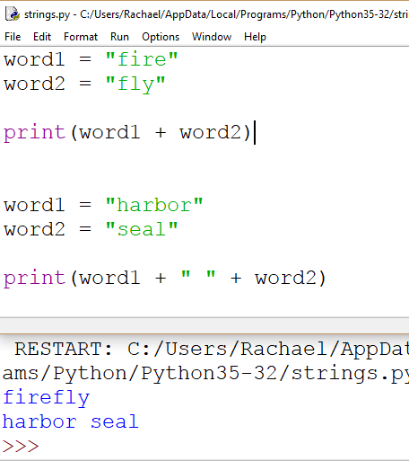
String Concatenation
Use the + symbol to concatenate two strings.
It will merge the two strings together.
It does not automatically add a space. If you want a space between words, concatenate a string containing just a space (“ “) between the words.

Slide 9
String Operations: in
<characters(s)> in <string>
We can use the keyword “in” to determine if a character or series of characters are contained in the string

Slide 10
String Operations: in
“i” in <“pineapple”>
Boolean: evaluates to True or False
The character(s) should be surrounded in quotes
The string can be a literal or a string saved in a variable

Slide 11
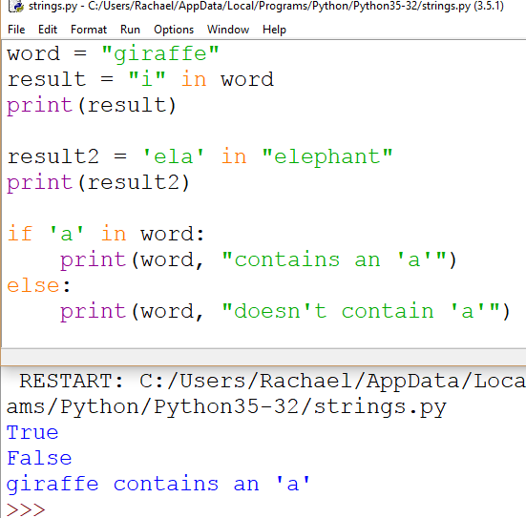
Character(s) in String
Remember, character in string is a Boolean so it returns true or false.
We can use it in an if-statement since if-statements evaluate Booleans.

Slide 12
String Indices
Why? Indices are something you’ll see a lot!
What? Accessing a string at an index allows us to access one character in the string.
How? We access an index of a string by using the string name, square brackets [ ], and the position of the element we want to access. (e.g. name[0])

Slide 13
String Indices
The first character in the string is at index 0, and the indices increase as you go through the string.
“Zero-based indexing”

Slide 14
Index Positions
0
name[0] accesses the first character,
1
name[1] the second character,
2
name[2] the third character, etc.

Slide 15
Index Positions
The last character is at index length - 1
Where length is the number of characters in the string.

Slide 16
Index Positions Illustrated
animal = “giraffe”
animal[0] = ‘g’
animal[1] = ‘i’
animal[2] = ‘r’
animal[3] = ‘a’
animal[4] = ‘f’
animal[5] = ‘f’
animal[6] = ‘e’
g | i | r | a | f | f | e
0 | 1 | 2 | 3 | 4 | 5 | 6

Slide 17
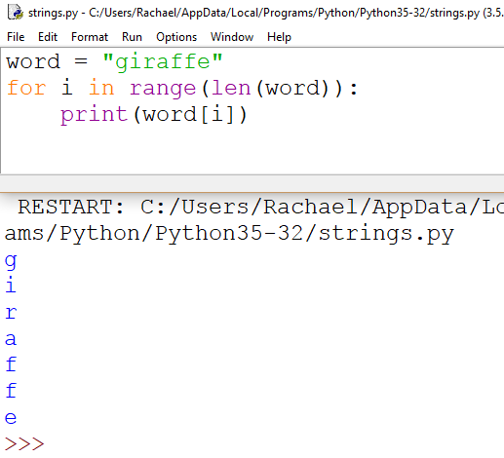
Looping Through a String
Use a loop to access each element of the string at indices 0 through n-1.
len(word) gives up the number of characters in the string.
The for-loop automatically starts i at 0 and goes up to (not including) the given range end point. So the loop accesses every element in the string.

Slide 18
Negative Index Positions
The last character in the string is at index -1, and the indices decrement as you go backwards through the string.
name[-1] accesses the last character, name[-2] the second to last character, name[-3] the third to last character, etc.
The first character is at index -n, with n being the number of characters in the string.

Slide 19
Negative Index Example
animal = “giraffe”
animal[-7] = ‘g’
animal[-6] = ‘i’
animal[-5] = ‘r’
animal[-4] = ‘a’
animal[-3] = ‘f’
animal[-2] = ‘f’
animal[-1] = ‘e’
g | i | r | a | f | f | e
-7 | -6 | -5 | -4 | -3 | -2 | -1

Slide 20
Iterating through Strings
word = “apple”
for ch in word:
print(ch)

Slide 21
String Operations: SlicE
Slice a string into a substring
Specify the starting and ending indices for the slice
word[0:3]

Slide 22
String Operations: SlicE
The number on the left of the colon is the first index to include and the number on the right of the colon is the endpoint, not inclusive
If you slice a word with [0:len(word)] you will get the whole word

Slide 23
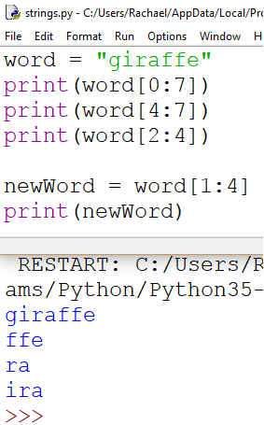
String Slice
Note: Remember the last index is not inclusive

Slide 24
String Operations Summary
Slicing
animal = “giraffe”
print(animal[2:5])
Character in String
‘r’ in animal
Concatenation
Join multiple strings with the + symbol
Length
Get the length of a string using the len() function
len(first)
g | i | r | a | f | f | e
0 | 1 | 2 | 3 | 4 | 5 | 6

Slide 25
Lists
A list is an ordered sequence of items.
Animals
giraffe
seal
uromastyx

Slide 26
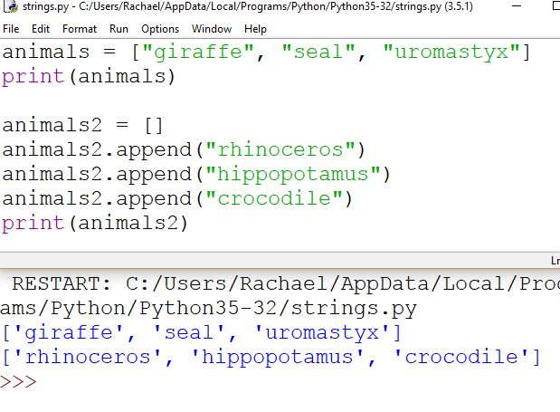
Inserting to a List
There are 2 ways to create a list.
Initialize the list literally with the values it will contain.
Or declare the list, and then “append” the items to the list.
You can also append to a list later to add items.

Slide 27
Iterating through a list
for animal in animals:
print(animal)

Slide 28
Lists: Indices
We can access indices of lists just like strings!
Support positive and negative indexing like with strings
animals[0] = “giraffe”
animals[1] = “seal”
animals[2] = “uromastyx”
“giraffe” | “seal” | “uromastyx”
0 | 1 | 2

Slide 29
Lists of Strings
 | 0 | 1 | 2 | 3 | 4 | 5 | 6 | 7 | 8
0 | g | i | r | a | f | f | e
1 | s | e | a | l
2 | u | r | o | m | a | s | t | y | x
animals[0] = “giraffe”
animals[0][2] = “r”
animals[1][3] = “l”

Slide 30
Other List Operations
Remove
animals.remove(“seal”)
Reverse
animals.reverse()
Sort
animals.sort()
Delete
del animals[2]
Slice
animals[0:2]
Item in List
“seal” in animals
Boolean

Slide 31
Frequency List
Keeps a tally of how many times something occurred
Frequency of Letters in Apple
Create a list with the number of indices as options (for letters, it’d be 26)
Initialize every element of that list to zero
Parse your data: Each time you encounter an instance, increment the corresponding index by one
Letter | Frequency
A | 1
P | 2
L | 1
E | 1

Slide 32
Frequency List Example Problem
Create a list of numbers with values from [0, 10]
Determine how many times each number occurs in that list

Slide 33
Frequency List Example
numbers = [7,5,4,5,3]
value | 7 | 5 | 4 | 5 | 3
Index | 0 | 1 | 2 | 3 | 4

Slide 34
Frequency List Example
numbers
frequency
value | 7 | 5 | 4 | 5 | 3
Index | 0 | 1 | 2 | 3 | 4
value | 0 | 0 | 0 | 0 | 0 | 0 | 0 | 0 | 0 | 0
index | 0 | 1 | 2 | 3 | 4 | 5 | 6 | 7 | 8 | 9

Slide 35
Frequency List Example
numbers
frequency
value | 7 | 5 | 4 | 5 | 3
Index | 0 | 1 | 2 | 3 | 4
value | 0 | 0 | 0 | 1 | 1 | 2 | 0 | 1 | 0 | 0
index | 0 | 1 | 2 | 3 | 4 | 5 | 6 | 7 | 8 | 9

Slide 36
Frequency List Example
numbers = [7,5,4,5,3]
index | value
0 | 7
1 | 5
2 | 4
3 | 5
4 | 3

Slide 37
Frequency List Example
frequency
numbers
index | value
0 | 0
1 | 0
2 | 0
3 | 0
4 | 0
5 | 0
6 | 0
7 | 0
8 | 0
9 | 0
index | value
0 | 7
1 | 5
2 | 4
3 | 5
4 | 3

Slide 38
Frequency List Example
frequency
numbers
index | value
0 | 0
1 | 0
2 | 0
3 | 1
4 | 1
5 | 2
6 | 0
7 | 1
8 | 0
9 | 0
index | value
0 | 7
1 | 5
2 | 4
3 | 5
4 | 3

Slide 39
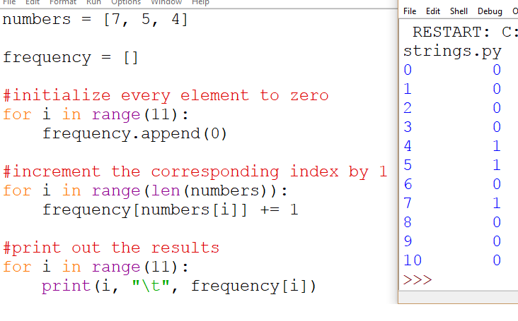
Frequency List

Slide 40
Character Operation: ord()
Every character has a number associated with it (ASCII value)
The value associated with ‘a’ is 97, ‘b’ is 98, ‘c’ is 99, etc.
We can find the number by using the ord() function
ord(‘a’) will return 97

Slide 41
Character Operation: chr()
Every character has a number associated with it (ASCII value)
The value associated with ‘a’ is 97, ‘b’ is 98, ‘c’ is 99, etc.
We can find the character by using the chr() function
chr(97) will return ‘a’

Slide 42
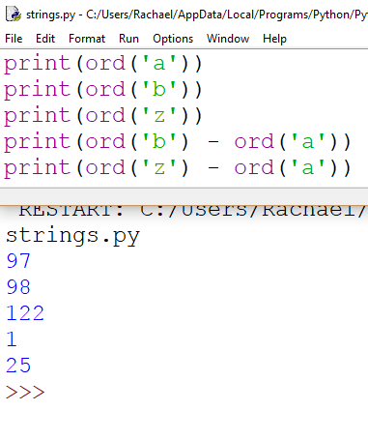
Ord()
ord() returns the number (ASCII value) associated with a letter
Subtract ‘a’ from the ord() of a letter to find out how far a letter is from a

Slide 43
Distance From A
a | b | c | d | e | f | g | h | i | j | k | l | m
0 | 1 | 2 | 3 | 4 | 5 | 6 | 7 | 8 | 9 | 10 | 11 | 12
n | o | p | q | r | s | t | u | v | w | x | y | z
13 | 14 | 15 | 16 | 17 | 18 | 19 | 20 | 21 | 22 | 23 | 24 | 25

Slide 44
Frequency List Example Problem
Determine how many times each letter appears in a string

Slide 45
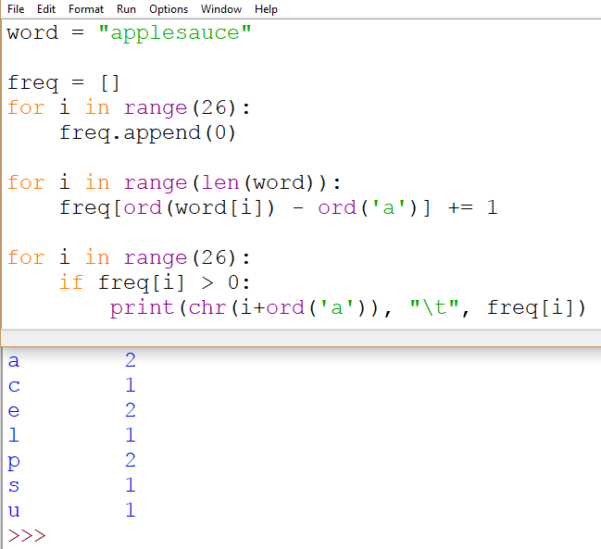
Frequency List Example Problem

